Slide 1
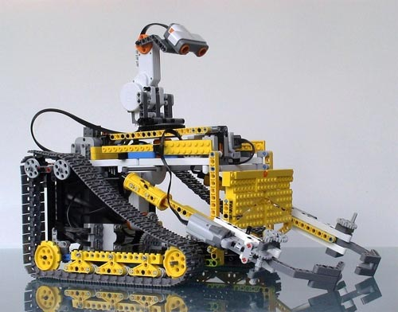
Robot detection of Improvised explosive devices (IEDS) se3303 – Final presentation
Team C.L.E.A.R –
Convoy Level Explosive Ammunition Removal
Chris Aall, Steve Mazza, Mike Oexmann, Liz Swisher
9 Mar 2012
Notes:
Introduce team.
Introduce team members
We were asked to evaluate from a systems engineering perspective 4 candidate prototype systems designed to affect area clearing of IEDs.
We briefly discuss the problem and proposed solutions. Then we describe our evaluation process and present our findings.
We will be making a recommendation to you regarding the best overall candidate solution.

Slide 2
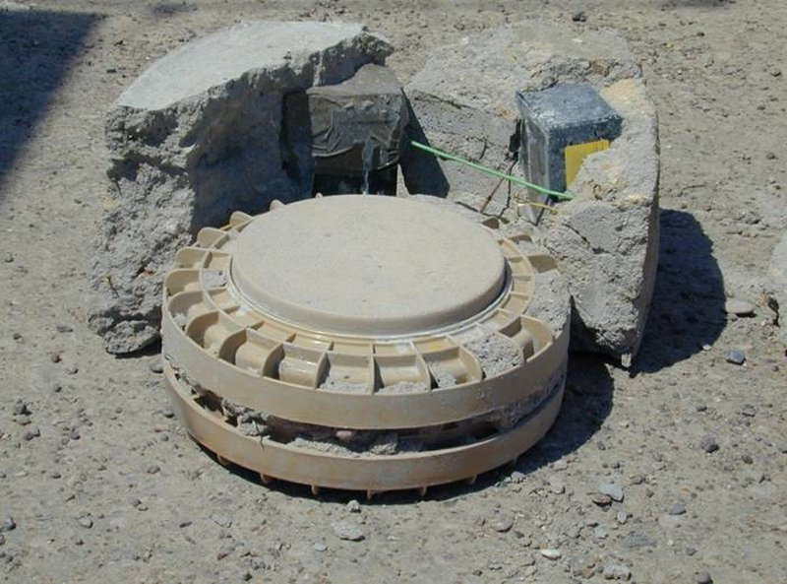
PROBLEM Description
Notes:
Improvised Explosive Devices (IEDs) are commonly used by enemies of the United States in current theaters of operation and pose a significant risk to both the operational security of the mission and the health and safety of our troops. The problem of detecting and neutralizing IEDs falls into two domains, route clearing and area clearing.
Route clearing removed IED threats from convoy routes, roadsides, and other heavily travelled paths. The greatest impact of route clearing is to our warfighters as it directly affects troop movement.
Area cleaning is a somewhat different activity and generally involves detecting and neutralizing all IEDs in a given area of interest. This could be an abandoned village, a town center, or any other area where our enemy anticipates sufficient US and coalition force strength to cause harm. Besides being a direct threat to our warfighters, these IEDs pose a significant threat to the general indigenous population. And so area clearing of IEDs not only has an impact on operational security, mission completion, and the welfare of our warfighters, it also impacts the humanitarian side of our mission in current theaters of operation.

Slide 3
Process
Requirements Analysis
Test and Evaluation (T & E)
Cost Analysis
Overall Measures of Effectiveness (OMOE) and Risk Analyses
Trade-offs and System Selection
Conclusion and Recommendation

Slide 4
Critical STAKEHOLDERS
Systems Engineering Experts, Inc. (SEE, Inc.)
Testers-R-Us (responsible for testing the prototype against requirements)
Contracting Companies (competing in advanced development prototype competition)
Warfighter (the end user)
Taxpayer (financial support)
Congress (budget approval)
PEO-IED (where our IPT works)
Lego, Inc. (manufactures a critical component used to create METAL-V)
PEO C3T
PM Mission Command
Tank Automotive Research, Development and Engineering Center (TARDEC)
Project Manager Close Combat Systems (PM CCS)
Product Manager Countermine and Explosive Ordnance Disposal (PdM CM&EOD)
Product Manager IED Defeat/Protect Force (IEDD/PF)
Notes:
Due to the prevalence of the problem caused by IEDs, the greatest impact is to the warfighter and so they represent the most important stakeholder.
They are followed by the supporting PEOs, PMs, and PdMs, various contractors, material suppliers, testers, engineers, and finally Congress and the taxpayers.

Slide 5
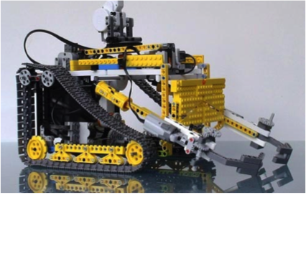
System Description
Notes:
We evaluate 4 variants of a prototype system designed to address area clearing of IEDs. We begin by understanding the problem space and collecting customer requirements.
Then, using Quality Function Deployment (QFD) diagrams, we move our understanding from Customer Requirements to a physical description of the system. Since we have requirements from two theaters of operation, Afghanistan and Iraq, we began by creating two versions of the QFD 1, mapping Customer Requirements to Design Characteristics. We then take the Design Characteristics and map those to Functions in the QFD 2 diagrams. Lastly we map Functions to physical Forms in the QFD 3 diagrams.
So, we took a slightly different path in arriving at our conclusions (work the process and see how much agreement we have in the end vs. averaging the requirements rankings).
We notice that there is an extremely high correlation among the Forms derived from both theaters in QFD 3. This gives us a high degree of confidence that we can meet customer expectations in both theaters based on our gathered requirements and system drivers.

Slide 6
PHYSICAL System
IED Sensor
Comms
Chassis & Drive Train
NXT Brick
Notes:
We arrive at the following physical description of the system (no surprises).
IED Sensor: The Improvised Explosive Device (IED) Sensor performs the critical task of locating and identifying an IED within the operational range of the sensor. IED sensors are developed by the Army and continually improved 2 and so this is an excellent opportunity for Systems Engineers to define on interface (or control point) through which the IED sensor will communicate its findings to the rest of the SMETAL-V system. In this way, new sensor technology can be developed, adopted, and integrated into the current generation product with a minimum of re-work.
Onboard Communications: provide a path for the two-way flow of data between the operator and the SMETAL-V system and between the SMETAL-V system and the point of data collection in the event that these are not the same. Methods of communication include radio, Bluetooth, WiFi, Xbee, and others. Each protocol has strengths and weaknesses that affect range, jamming, duplex, error correction, encryption, and reliability, among others. Communications protocols should be carefully evaluated for DoD compliance and suitability for use in a tactical environment. Also, the need for integration with programs of record might dictate the method of communication.
Chassis: The chassis serves as the basis of of the SMETAL-V platform and is the fixture onto which all other parts are fixed. Reducing chassis weight is key to maintaining overall weight goals, balanced off against the necessity to provide a robust and reliable product. Carefully choosing material (e.g., polycarbonite, carbon fiber, aluminum) will help engineers meet critical design goals.
Drive Train: The drive train provides locomotion to the SMETAL-V system and ultimately determines the type of terrain that the platform can traverse as well as the speed with which it can do so. Electric motors develop full torque at all speeds, are efficient, and inexpensive to use over the lifecycle of the product. They are also natural to control from the NXT Brick. Tracked vehicles are somewhat more expensive but provide more precise maneuverability and the ability to climb steeper inclinations.
NXT Brick: Built by Lego, the NXT Brick is an inexpensive, readily available programmable micro-controller that combines standardized interfaces with an easy-to-program core. Programming is extensible by third parties and has been opened up to leverage the power and existing base of the C programming language. The NXT Brick R will act as the control point between the operator and the SMETAL-V platform, allowing the operator full control of the vehicle’s capabilities.

Slide 7
Key Performance parameters
Mission Reliability
DRM Elapsed Time
DTR Time
Operational Team Size
Refueling Time
Life-cycle cost
Operational Availability
Vehicle Weight
Notes:
The following key performance parameters were among those identified by the requirements analysis.
The top-level system requirements have been prioritized based on operational stakeholder (end user) preference. The top priority of any user is typically safety. In this case, the operational stakeholder is most interested in the system’s ability to correctly perform its mission to detect IEDs and therefore prevent fatal injury to the operator and other friendly personnel.
Following the system’s correct operation, the operational stakeholder is determined to be most interested in how the system will be operated. How much training is required? How long does the system take to deploy? How difficult is the system to use? These types of requirements are factors which directly impact the end user and play a role in user acceptance. Operational stakeholders must also consider the transport of the systems they use; therefore weight, volume, and drop height are areas of principal interest.
The system requirement having the lowest priority is life-cycle cost. As would be expected, the end is typically wiling to trade cost off against safety and operational effectiveness. This requirement would have much higher priority, however, if viewed from a procurement office’s point of view.

Slide 8
System thresholds
Parameter | Threshold | Goal
Mission Reliability (DRM) | 0.9 | 0.95
Operational Availability | 0.8 | 0.9
Life-cycle Cost per Unit | $50K | $25K
Vehicle Weight | 18oz | 14oz
Vehicle Drop Height | 1” | 3”
Refueling Time | 60 sec. | 30 sec.
DRM Elapsed Time | 5 min. | 3 min.
Deployed-to-Ready Time | 10 min. | 5 min.
SMETAL-V Storage | 216 cu. In. | 120 cu. In.
Operational Team Size | 2 warfighters | 1 warfighter
Notes:
Prioritized based on operational stakeholder (end user) preference.
Data gathered from soldiers in Afghanistan and Iraq.

Slide 9
System requirements
The system shall have a mission reliability of at least 0.90.
The system shall have an operational availability of at least 0.80.
The system shall indicate a false negative less than 3% of the time
The system shall indicate a false positive less that 2% of the time.
The system shall successfully detect and distinguish 95% of threats in a given area over a given time.
The system shall successfully alert the IED-clearance operator of a threat 98% of the time.
The system shall require an average training period not to exceed 4 hours.
The system's deployment-to-ready time shall not exceed 10 minutes.
The system shall have an average usability score of at least 8 based on end-user input.

Slide 10
System requirements (cont.)
The system shall require no more than 2 people to operate.
The system shall not require any specialized parts or training for routine maintenance or repair.1
The system vehicle's weight shall not exceed 18 ounces.
The systems SMETAL-V storage container shall have a volume not to exceed 216 cubic inches.
The system's DRM elapsed time shall not exceed 5 minutes.
The system vehicle shall have a drop height of at least 1 inch.
The refueling time of the system shall not exceed 60 seconds.
The system's life-cycle cost shall not exceed $50,000.

Slide 11
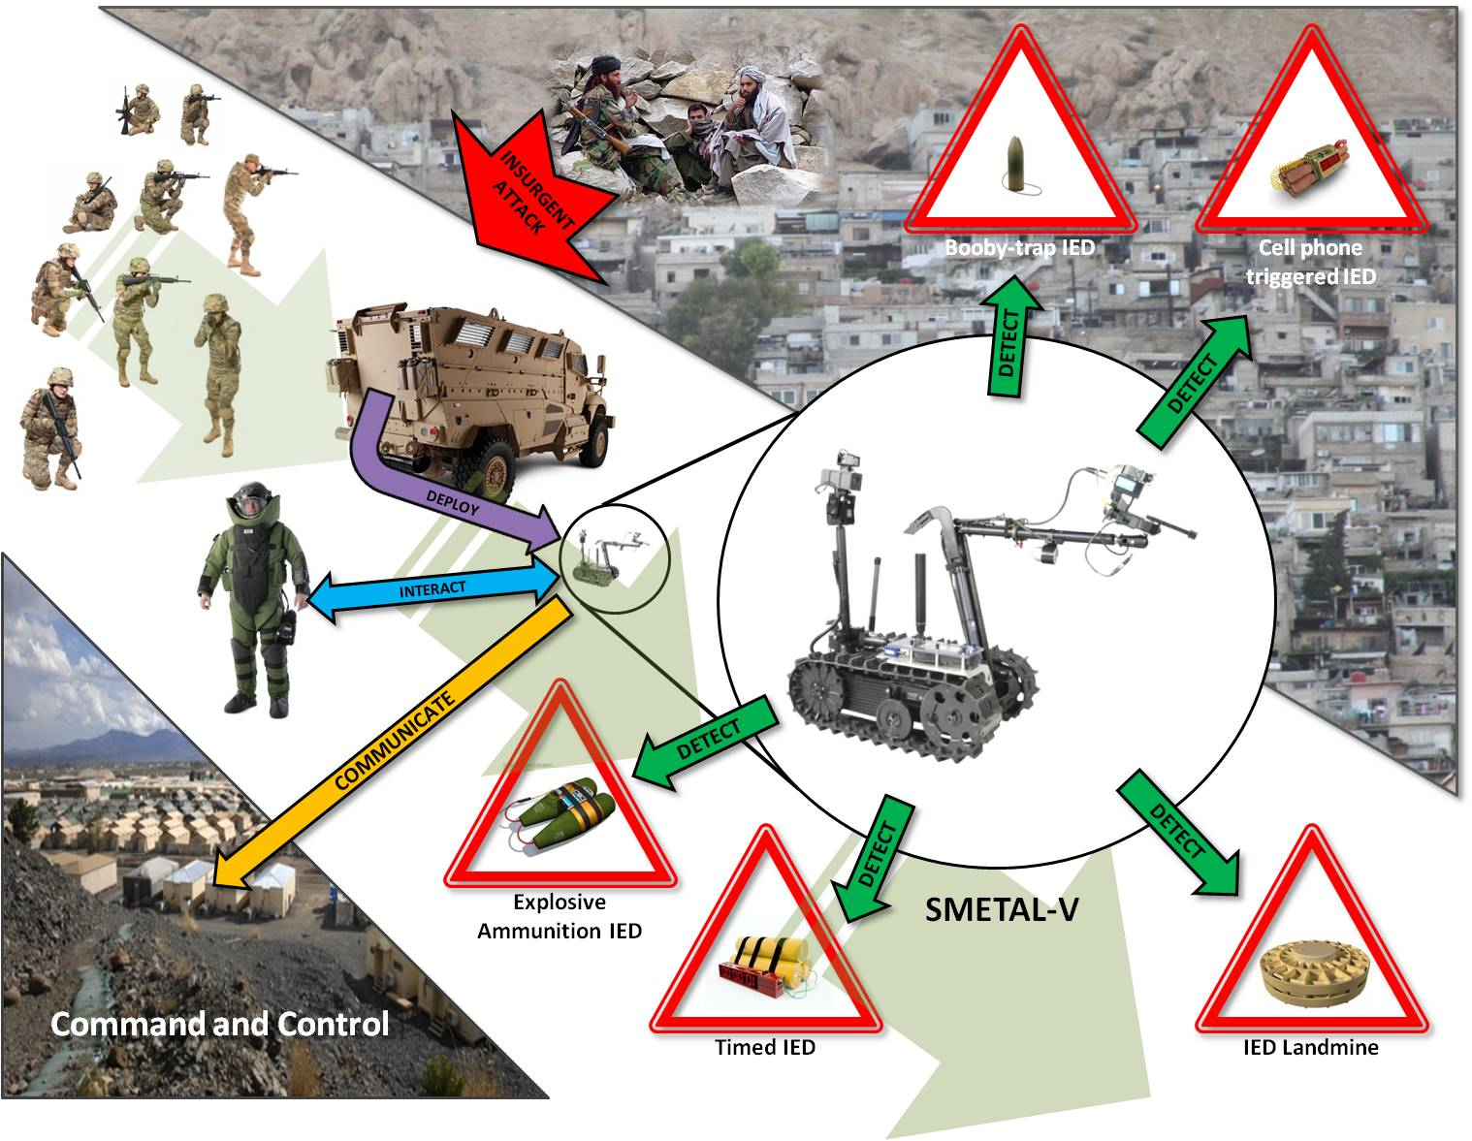
ov-1
Notes:
The OV-1 shows a high-level conceptual view of the operational and deployment environment of the system as well as all of its physical components, operators, and support.

Slide 12
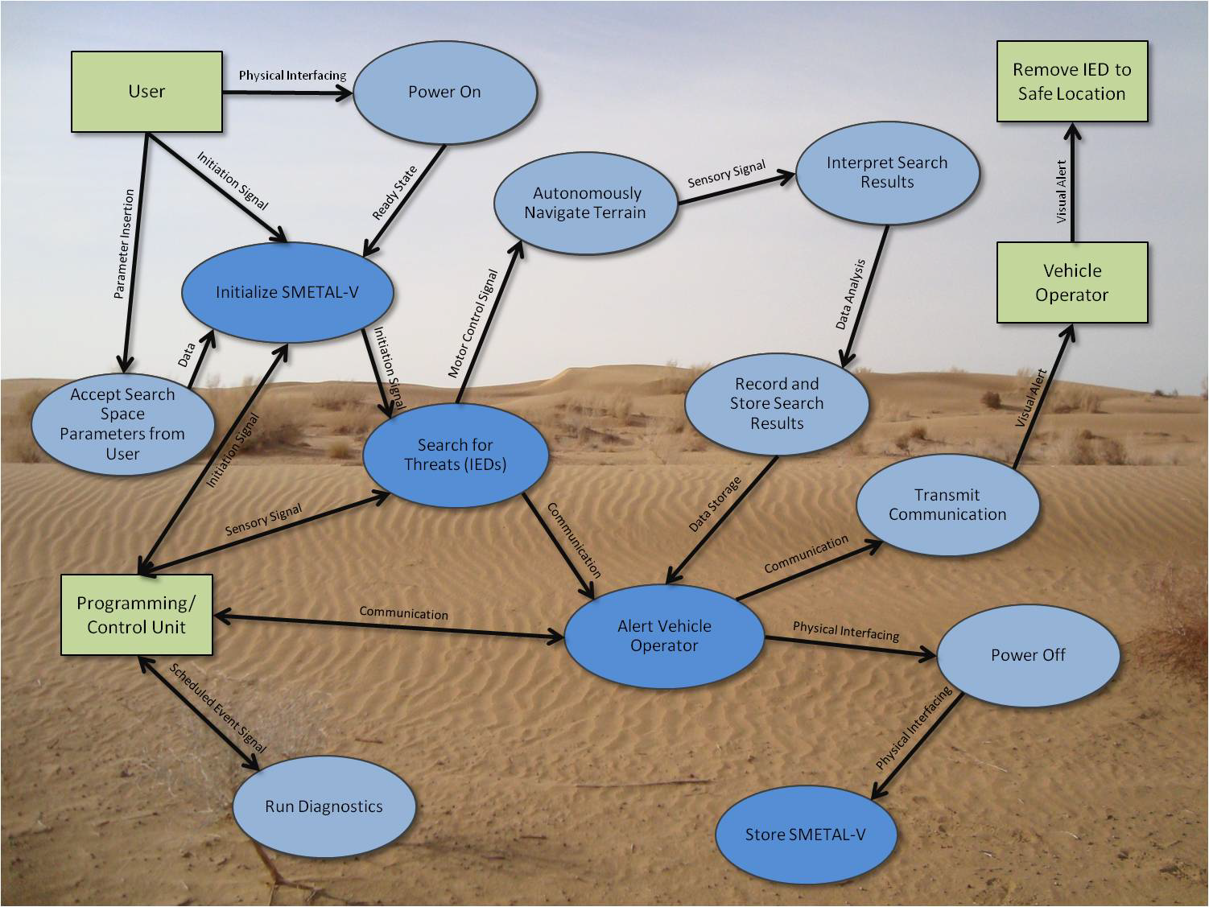
Sv-4b
Notes:
SV-4b is based off the OV-1 and was a useful tool in determining top-level system requirements.
The following figures lend insight into the system in several ways. They provide us with an increased understanding of logical encapsulation of data and functionality that informs software best practices, modular design, distributed development, and component re-use. Similarly, they help us to understand the physical encapsulation of functionality that informs modular design and manufacturing.
Since system timing and cohesiveness is critical to a well-functioning system and ultimately to a high mission success rate, it is important to note that the diagrams also inform our understanding of data flow needs including system timing requirements and lend an increased understanding of requirements for interoperability among component system parts.

Slide 13
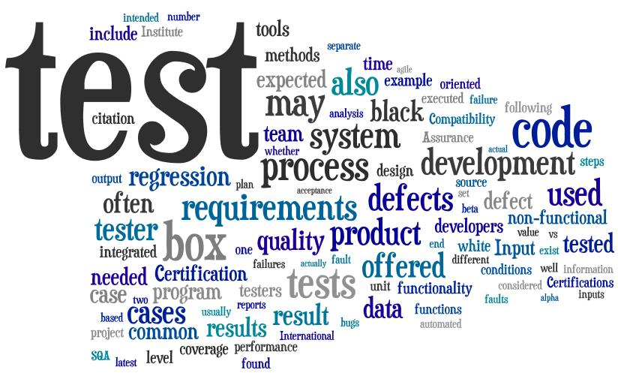
Test and Evaluation
Notes:
In order to successfully achieve the goal of providing area specific, detection and clearance of improvised explosive devices (IEDs) while meeting stakeholder requirements, proper testing, evaluation and analysis was carried out. Testing is a continuous process that should occur throughout the system’s lifecycle. There are two reasons for test and evaluation: verifying specifications/requirements and managing risk.

Slide 14
Limited objective exercise
Determine the size of the SMETAL-V Storage Container.
Place the SMETAL-V in the deployed state with batteries removed and SMETAL-V Programming Unit off.
Place the SMETAL-V into the ready state and determine Deployed-to-Ready Time.
Drop the SMETAL-V onto the DRM start position and verify Vehicle Drop Height threshold.
Carry out the DRM and measure DRM Elapsed Time. Then place the SMETAL-V in the ready state.
Carry out a battery replacement with new batteries to determine Refueling Time.
Carry out the DRM a second time and measure DRM Elapsed Time. Then place the SMETAL-V in the ready state.
Weigh the SMETAL-V to determine Vehicle Weight using a suitable postage or other scale.
Place the SMETAL-V into the deployed state, collect and organize the recorded data, and terminate the LOE.
Notes:
The SMETAL-V Limited Objective Exercise (LOE) was used to test the various alternatives against a standard test set to gage the progress of the prototypes. The SMETAL-V program has had four respondents to the advanced development prototype competition, three of which developed working robots that were able to complete the LOE. To remove bias, each of these variants competing in the LOE were identified by the labels A, B, C, and D respectively. A contractor performed the LOE with the aid of PEO-IED and results were certified by government T&E personnel.

Slide 15
Test results
Given a thorough and complete analysis of the provided data and test results, prototype D has been determined to outperform prototypes A, B, and C overall.
Notes:
The assessment of the individual functional features of the SMETAL-V system next result in further technology trade off studies and potentially function as guideline for capability integration. Through the use of variance analysis, a report on the statistical similarity of test data means to the provided thresholds and goals is generated. It was concluded that such an assessment alone would not provide for a complete analysis of the highest performing variant, but instead only state absolute similarity between a data set and a constant value. Further analysis revealed that prototype variant D is the highest performing overall, and still meets all of the KPP thresholds.
It is our recommendation that we proceed with development and further test and evaluation of prototype variant D. A higher level effort will be applied to improving the DRM Elapsed Time KPP values of variant D to ensure that the prototype variant meets or exceeds the goal value.

Slide 16
Cost Analysis
Cost by Variant for a Single System
Cost by Variant for 10 Systems at a Discount of 6%
Rankings of Variants based on Cost (LIB):
Variant A (meets threshold KPP)
Variant C (meets threshold KPP)
Variant D (does not meet KPP)
Variant B (does not meet KPP)
Notes:
An important metric of any system is cost. To determine whether or not each variant could meet cost constraints, a cost assessment was performed.
Both LCC and TOC were estimated for comparison purposes. The team evaluated cost for a single system as well as looking into the costs of multiple systems including a 6% discount (the discounted costs are more representative of what we could expect to see once the systems/system components are mass production)
In determining TOC, certain assumptions were used such as a single, initial training cost per system, and a system production of 10 units over the next 10 years.
Overall, purely looking at JUST the LCC, indicated that both variants A and C were able to meet the cost KPP, however, additional analysis looking at CAIV and potential return on investment is required and discussed later on within this presentation.

Slide 17
Overall Measures of effectiveness
Comparison of OMOEs by Variant
Rankings of Variants based on OMOEs (HIB):
Variant D
Variant C
Variant A
Variant B
Notes:
By creating weighting for specific KPPs, an OMOE score was calculated to rank the variants. This provides us with a quantifiable measure of overall system performance while still considering stakeholder preference.
Based on this calculation, Variant D outperforms all other variants.

Slide 18
OMOEs and Risk Analysis
Variant A
Variant B
Variant C
Variant D
Notes:
Risk Analysis of each Variant based on Selected Components
A risk assessment of each of the variants based on 4 selected components was conducted. This assessment helps to determine which systems are the most risky overall while providing details on which specific component adds or alleviates risk with regard to each variant. Each variant’s results can be seen in the four likelihood vs. consequence risk charts. Red indicating a high level of risk, yellow indicating a medium level, and green a low level.
In each case, we are examining the probability and potential negative result should a component fail to perform as intended.
Red = High Risk, Yellow = Medium Risk, Green = Low Risk.
Variant D is the only alternative with all low risk.

Slide 19
OMOEs and Risk Analysis Overall Risk Analysis of All Variants
Variant Ranking Based on Risk (LIB):
Variant D
Variant B & C (very similar risk levels)
Variant A
Notes:
This risk chart takes into consideration the results of each variant's risk assessment. Overall, Variant D shows the least amount of risk as all of the evaluated components have low risk levels.
No variant with high risk area
Variant D is only alternative with all low risk levels
- Variant A is only alternative with all medium risk levels, making it the most risky.

Slide 20
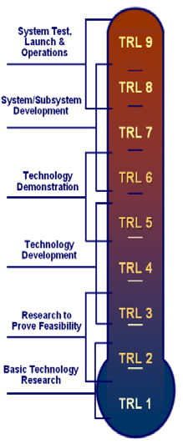
Technology readiness levels
TRL 7: Drive Mechanism (D)
TRL 6: Power Source (B & C),
Drive Mechanism (A & B). Architecture (D)
TRL 5: Sensor (D), Drive Mechanism (C)
TRL 4: Sensor (A & D), Power Source (A),
Architecture (A&B&C)
TRL 3: Sensor (B & C)
*Variants color-coded to visually analyze
overall TRL level by variant
Notes:
Another contributor to overall risk is technology maturity. Each system variant was also evaluated based on its components’ maturity level. To measure maturity, the DOD’s standard TRL measurement tool was used. This tool is an indicator of what level of effort has been previously invested into a specific technology. Typically, those technologies reaching a level of around 6 or 7 are considered mature enough for integration into a system. In our case, the selected components fall within the range of TRL 3 – 7. Those components will low TRLs will require further research and development and therefore carry a certain amount of risk.
The sensors for variants B and C are the least mature and would need to be monitored closely moving forward to ensure technology is meeting thresholds without cost or schedule overruns.
Overall, Variant D is considered the most mature.

Slide 21
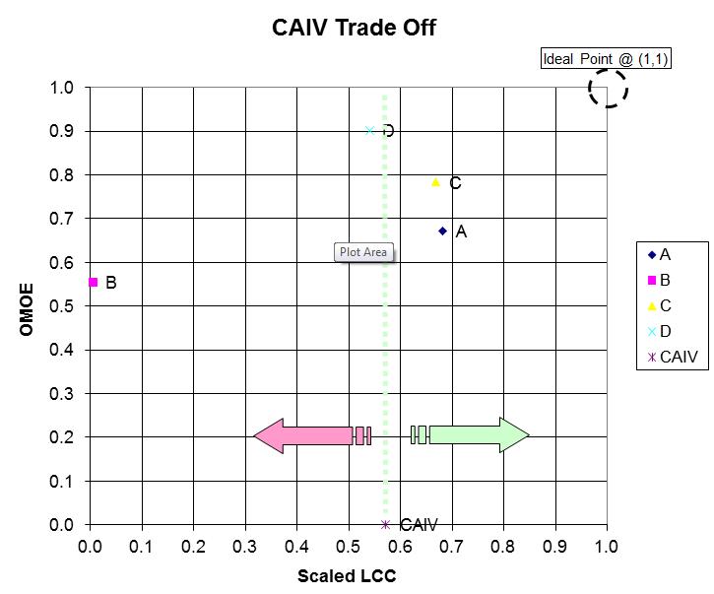
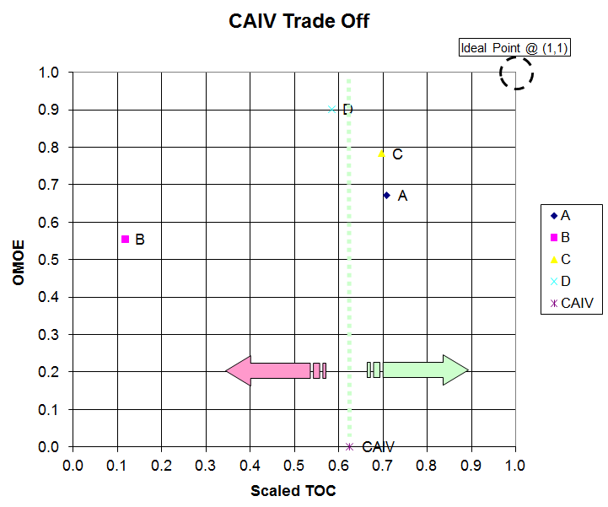
caiv assessment
Notes:
The intent of CAIV assessment is to provide the customer/warfighter with highly capable systems that are affordable over the life cycle. It takes both cost and performance into consideration to ensure the best system is selected achieving the highest return on investment. (In other words, ensure the best system is selected achieving the highest performance at the most competitive cost).
Variant that is dominated: B Variants that are Non-Dominated: A, C & D (therefore highest performing) Exceed CAIV threshold: A & C Closest to ideal point through a Euclidean distance assessment will indicate highest performing variant in regards to cost and performance. Furthermore, the TOPSIS assessment also indicated that Variants C and D were furthest away from the NON-IDEAL, while simultaneously being closest to the IDEAL

Slide 22
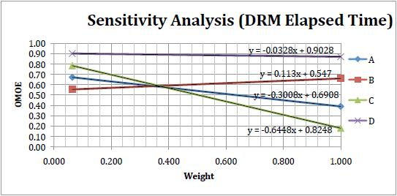
Sensitivity assessment
Notes:
What effect on overall performance does an increase in weighting have?
Design Reference Mission (DRM), in order to change results DRM elapsed time would need to significantly increase in weighting to become the highest weighted parameter.
Due to need in such a drastic increase in weighting of DRM elapsed time to modify overall results, we feel our initial weighting was adequate.
Mission Reliability was already highest weighted KPP and would need a significant weight increase to change OMOE results. We are confident that our initial weighting of Mission Reliability did not create a bias in our analysis.
The main question this analysis aims to solve: What effect on variant overall performance does an increase in weighting have?
This slide shows sensitivity assessment for DRM Elapsed Time
Process: Increase weight of most highly prioritized OMOEs. See the effect the weighting changes have on overall score. Draw conclusions on what variants score most desirably when weights are increased due to stakeholder needs.

Slide 23
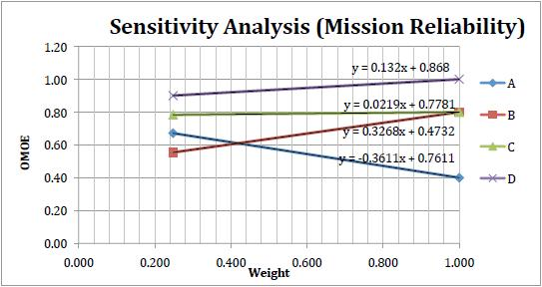
Sensitivity assessment
Notes:
This slide shows sensitivity assessment for Mission Reliability
Results:
Variant D maintains highest performance even after increase in priority OMOE weights.
Variants A and C consistently show negative trending upon increase of weighting.
In a nut shell, Variant D is most suitable for our customers/stakeholders due to its ability to complement their needs and priorities.

Slide 24
Conclusions
Variant D has performed significantly better in almost all OMOEs, while exhibiting reasonable lifecycle costs, total ownership costs, and low risk.
Variant D’s consistency in test results indicates that it exhibits stability and predictability in most aspects of operation.
Further developmental activities and spending shall be focused on variant D.

Slide 25
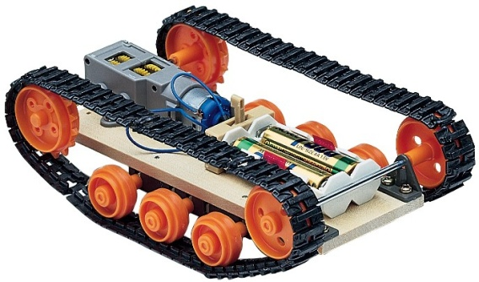
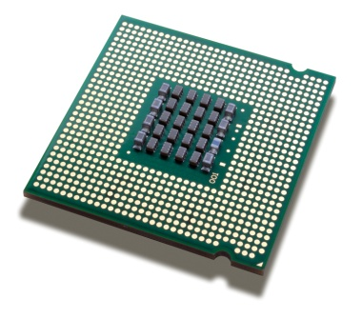
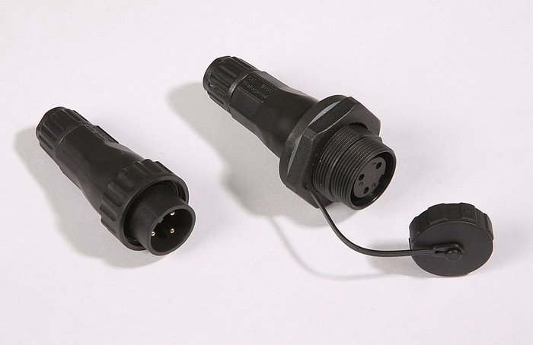
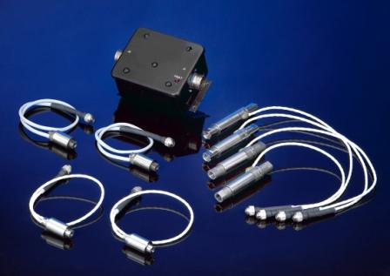
recommendations
Increase Mission Reliability – Incorporate water tight electrical connections and hardened (drive) track links.
Decrease DRM Elapsed time – Incorporate high speed drive train, faster computing hardware and higher sensitivity sensor system

